Slide 1
Annual Operating Plan
Citi Finance
April 6, 2023
Notes:
1

Slide 2
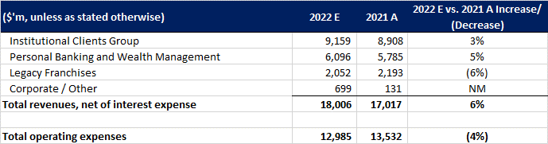
Financial Forecast to 31 Dec ’22
ICG’s revenue is expected to increase to $9.2 billion (i.e., YoY 3% increase), as strength in Treasury and Trade Solutions (TTS), Securities Services, and Fixed Income Markets is expected to be partially offset by a decline in Banking and Equity Markets.
PBWM’s revenues are expected to increase to $6.1 billion (i.e., YoY 5% increase) due to net interest income growth, driven by strong loan growth across US Personal Banking and higher interest rates, which is expected to be partially offset by a decline in non-interest revenue, driven 1 by the lower investment product revenues in Global Wealth Management and higher partner payments in Retail Services.
LegacyFranchises’ revenues are expected to decrease to $2.1 billion (i.e., YoY 6% decrease), primarily driven by the reduction in revenues from the closing of five exit markets and the impact of the Korean consumer and Russian consumer wind-downs, partially offset by the Thailand consumer business gain on the sale.
Corporate/other revenue is expected to increase to $699 million from $131 million in the prior-year period, largely driven by higher net revenue from the investment portfolio, primarily due to higher interest rates.
Total revenues are expected to increase to $18 billion (i.e., YoY 6% increase), as strength in ICG’s revenue, PBWM’s revenues and Corporate/other revenue is expected to be partially offset by a decline in LegacyFranchises’ revenues.
Total operating expenses are expected to decrease to $12.9 billion (i.e., YoY 4% decrease) as Compensation and benefits, Premises and equipment, Technology / communication and Advertising and marketing expenses are decreased.

Slide 3
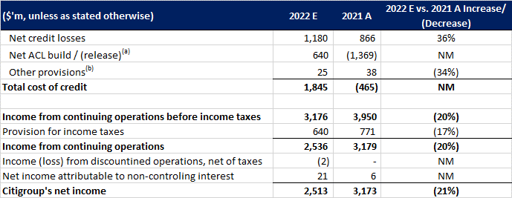
Financial Forecast to 31 Dec ’22 (cont.)
(a) Includes credit reserve build / (release) for loans and provision for credit losses on unfunded lending commitments. (b) Includes provisions for policyholder benefits and claims, HTM debt securities and other assets.
Total cost of credit is expected to increase to $1.8 billion.
Net income is expected to decrease to $2.5 billion (i.e., YoY 21% decrease)

